Slide 1

ITSE 4931: Operating Systems
Lisanu Tebikew
lisanu@gmail.com
Lecture 4: Process Management
March 19, 2015
Slides adopted from Prof. Matt Welsh, http://www.eecs.harvard.edu/~mdw/course/cs161/notes/processes.pdf

Slide 2
Process Management
This lecture begins a series of topics on
Processes
Threads
Synchronization
Probably the most important part of the class!
Definitely will be questions on this on the midterm and final
Today: Processes and process management
What are the units of execution inside of an OS?
How are they implemented inside of the OS? – Just scratch it.
What are the possible execution states of a process?
How does the OS switch between processes?

Slide 3
What is a Process?
The process is the OS abstraction for execution
A process represents a single running application on the system
AKA a job or a task or a sequential process
What is the difference between a process and a program?
A process is a program in execution
Processes are active entity while programs are static entities with the potential for execution

Slide 4
Processes
A process is an instance of a program being executed
Use “ps” to list processes on Linux/UNIX systems
Use “tasklist” to list processes in Windows systems
A process is named using its process ID (PID)

Slide 5
What is a process?
Process has three main components:
1) Address space
The memory that the process can access
Consists of various pieces: the program code, static variables, heap, stack, etc.
2) Processor state
The CPU registers associated with the running process
Includes general purpose registers, program counter, stack pointer, etc.
3) OS resources
Various OS state associated with the process
Examples: open files, network sockets, etc.

Slide 6
Process address space
The range of virtual memory addresses that the process can access
Includes the code of the running program
The data of the running program (static variables and heap)
BSS – Uninitialized Global variables
An execution stack
Local variables and saved registers or each procedure call
Why OS stack
When applications do a system call the executing OS function has local variables
But we don’t trust application’s stack since the user can modify it
Dedicated OS stack is needed for each process to store kernel data
OS Stack
Stack
Address Space
Heap
Uninitialized vars
(BSS segment)
Initialized vars
(data segment)
Code (text) segment

Slide 7
Process address space
The address space is how the process sees its own memory
Not necessarily how the memory is laid out in physical RAM.
Every process has its own separate address space.
Memory addresses are “private” to each process.
If Process A accesses address 0x3000, and Process B accesses 0x3000, they are accessing different physical memory locations.
Unless, the processes have been set up to share memory somehow.
This greatly simplifies programming model
E.g gcc doesn’t care that firefox is running
On a 32-bit machine, each process can address 2³² bytes (4GB) of memory!
How is this possible if you have less than 4GB on your machine?
This elaborate illusion is provided by the virtual memory system
We will discuss all of this in painful detail later in the class.

Slide 8
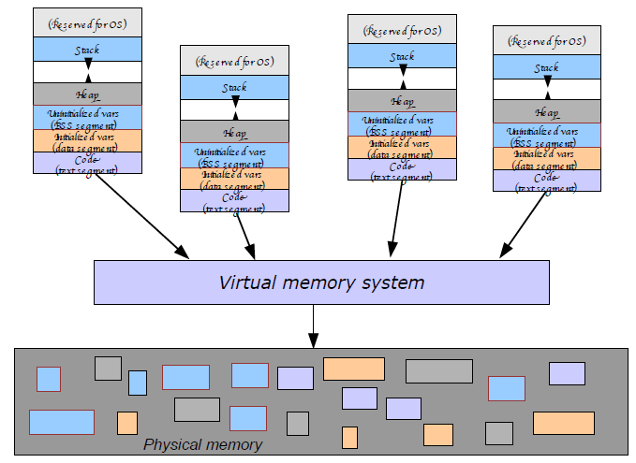
What happens with multiple processes?

Slide 9
Process States
Each process has an execution state
Indicates what the process is currently doing
Running:
Process is currently using the CPU
Ready:
Currently waiting to be assigned to a CPU
That is, the process could be running, but another process is using the CPU
Waiting (or sleeping or blocked):
Process is waiting for an event
Such as completion of an I/O, a timer to go off, etc. e.g ls | more
Why is this different than “ready” ?
As the process executes, it moves between these states

Slide 10
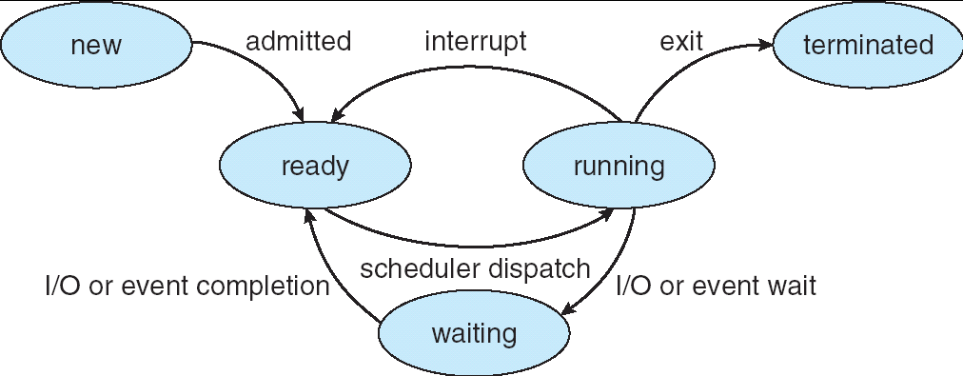
Lifecycle of a Process
As the process executes, it moves between these states
new: The process is being created
ready: The process is waiting to run
running: Instructions are being executed
waiting: Process waiting for some event to occur
terminated: The process has finished execution

Slide 11
Process Control Block
OS maintains a Process Control Block (PCB) for each process
The PCB is a big data structure with many fields:
Process ID
User ID
Execution state
ready, running, or waiting
Saved CPU state
CPU registers saved the last time the process was suspended.
OS resources
Open files, network sockets, etc.
Memory management info
Scheduling priority
Give some processes higher priority than others
Accounting information
Total CPU time, memory usage, etc.

Slide 12
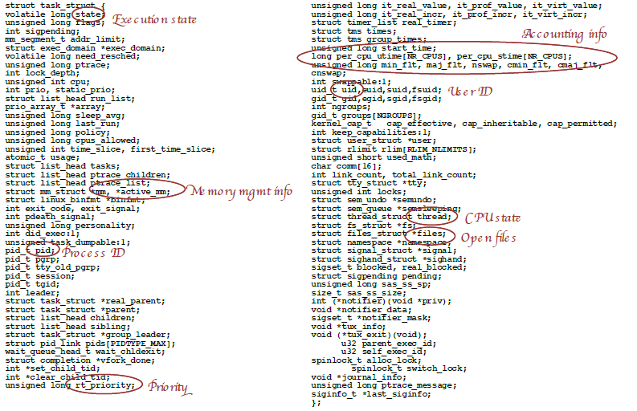
Linux PCB Structure (task_struct)

Slide 13
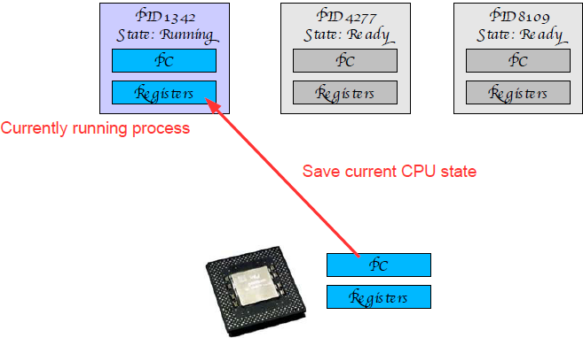
Context Switching
Switching the CPU to another process.
Context of running process (PCB) must be saved so that it is resumed later.

Slide 14
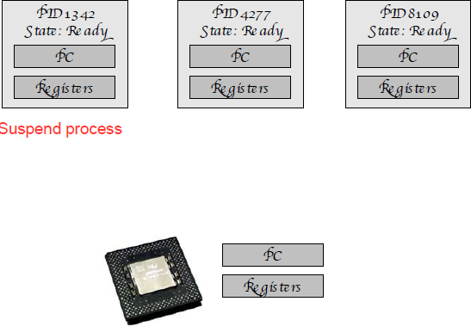
Context Switching
Switching the CPU to another process.
Context of running process (PCB) must be saved so that it is resumed later.

Slide 15
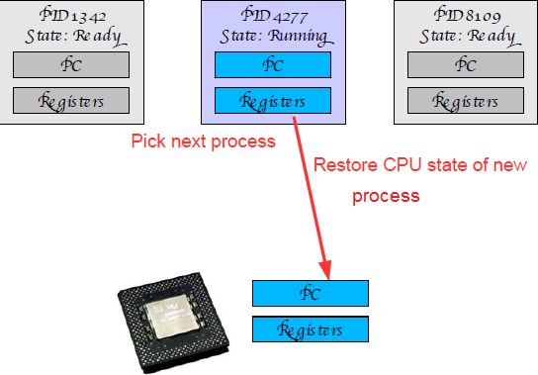
Context Switching
Switching the CPU to another process.
Context of running process (PCB) must be saved so that it is resumed later.

Slide 16
Context Switch Overhead
Context switches are not cheap
lot of CPU state to save and restore
Also must update various flags in the PCB
Picking the next process to run – scheduling – is also expensive
Context switch overhead in Linux 2.4.21
About 5.4 usec on a 2.4 GHz Pentium 4
This is equivalent to about 13,200 CPU cycles!
Aside: Android support multitasking by offering one foreground and many background jobs through services.
App registers and starts a service.
Service runs in place of the app even if the app is terminated or background.

Slide 17
Context Switching in Linux

Slide 18
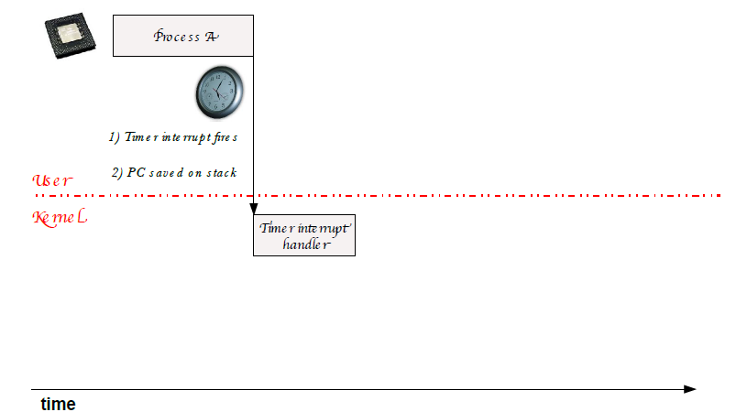
Context Switching in Linux

Slide 19
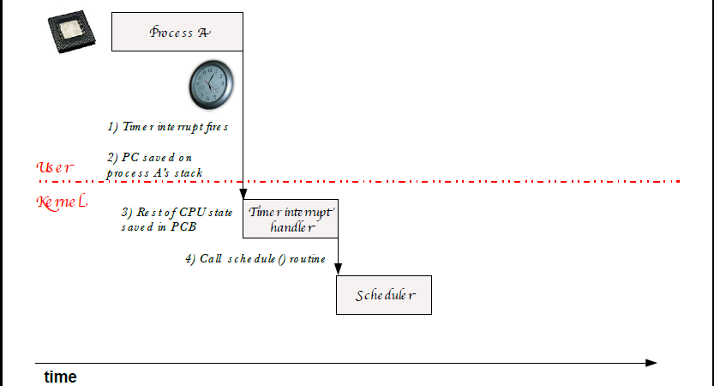
Context Switching in Linux

Slide 20
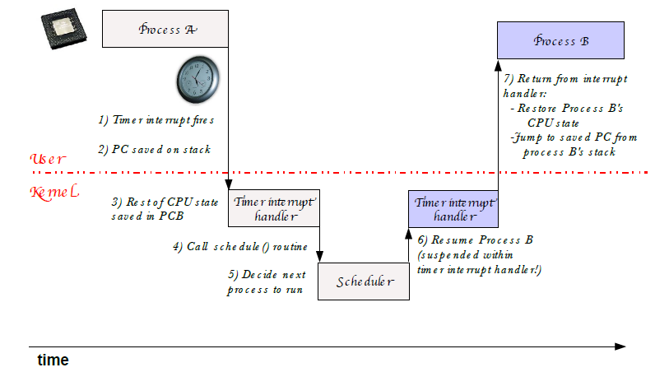
Context Switching in Linux

Slide 21
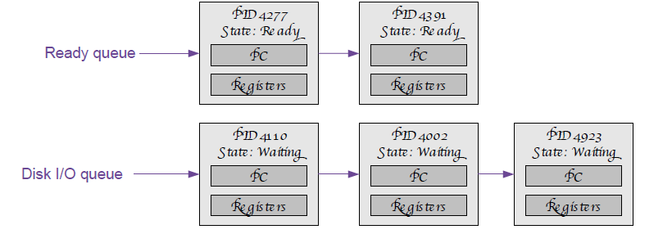
State Queues
The OS maintains a set of state queues for each process state
Separate queues for ready and waiting states
Generally separate queues for each kind of waiting process
e.g., One queue for processes waiting for disk I/O
Another queue for processes waiting for network I/O, etc.

Slide 22
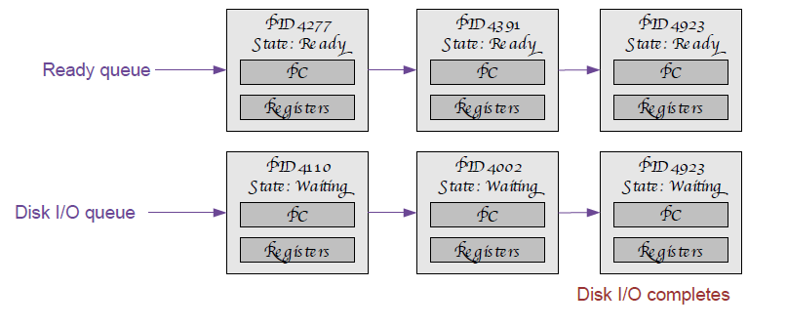
State Queue Transitions
PCBs move between these queues as their state changes
Initially put in ready queue (enqueue()).
When scheduling (Discussed next chapter) a process, pop the head off of the ready queue and start running it (dequeue())
it can move to waiting queue(E.g I/O request, Creating a new process and waiting)
Interrupt may occur and move to ready
When I/O has completed, move PCB from waiting queue to ready queue

Slide 23
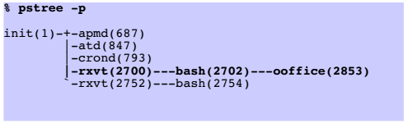
Process Creation
One process can create, another process
The original process is the parent
The new process is the child
Typically, new process is created when user runs a program
E.g., Double-click an application, or type a command at the shell
What creates the first process in the system, and when?
At boot time, the OS creates the ﬁrst process, called init, which is responsible for starting up many other processes
Parent process defines resources and access rights of children
e.g., child process inherits parent's user ID, initialization data

Slide 24
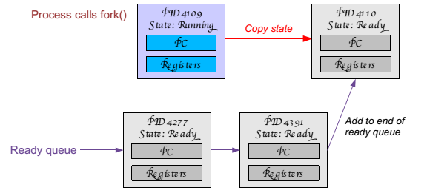
Process Creation: Unix/Linux
In Linux/Unix, processes are created using fork() system call
This creates an exact duplicate of the parent process!!
Creates and initializes a new PCB
Creates a new address space
copies of the entire contents of the address space of the parent
Initializes CPU and OS resources to a copy of the parent's
Places the PCB on the ready queue

Slide 25
Process Creation: Unix/Linux
New child process starts running where fork() system call returns!
And has an exact copy of the parent's variables.
int main(int argc, char **argv) {
int i;
for (i = 0; i < 10; i++) {
printf(“Process %d: value is %d\n”, getpid(), i);
if (i == 5) {
printf(“Process %d: About to do a fork...\n”, getpid()); int child_pid = fork();
}
}
}
What determines the order in which the two processes run???
The scheduler – discussed in another class
Process 4530: value is 0
Process 4530: value is 1
Process 4530: value is 2
Process 4530: value is 3
Process 4530: value is 4
Process 4530: value is 5
Process 4530: About to do a fork...
Process 4531: value is 6
Process 4530: value is 6
Process 4530: value is 7
Process 4531: value is 7
Process 4530: value is 8
Process 4531: value is 8
Process 4530: value is 9
Process 4531: value is 9

Slide 26
Process IDs
Each process has a unique positive process ID (PID)
getpid returns current process’s PID
getppid returns PID of parent of current process
return an integer value of type pid_t, which on Linux systems is deﬁned as an int
Defined in sys/types.h so you need to include it in your programs
Defined in unistd.h so you need to include it in your programs
For examples of usage see next slides.

Slide 27
Fork Example #2
Drawing fork graph helps determine the output
E.g consider Two consecutive forks
void main()
{
printf("L0\n");
fork();
printf("L1\n");
fork();
printf("Bye\n");
}
Bye
L1
Bye
Bye
L0
L1
Bye

Slide 28
Fork Example #3
Three consecutive forks
void fork3()
{
printf("L0\n");
fork();
printf("L1\n");
fork();
printf("L2\n");
fork();
printf("Bye\n");
}
Bye
L2
Bye
Bye
L1
L2
Bye
Bye
L2
Bye
Bye
L0
L1
L2
Bye

Slide 29
Fork Example #4
Nested forks in parent
void fork4()
{
printf("L0\n");
pid_t pid1 = fork();
if (pid1 != 0) {
printf("L1\n");
pid_t pid2 = fork();
if (pid2 != 0) {
printf("L2\n");
fork();
}
}
printf("Bye\n");
}
Bye
Bye
Bye
L0
L1
L2
Bye

Slide 30
Fork Example #5
Nested forks in children
void fork5()
{
printf("L0\n");
if (fork() == 0) {
printf("L1\n");
if (fork() == 0) {
printf("L2\n");
fork();
}
}
printf("Bye\n");
}
Bye
L2
Bye
L1
Bye
L0
Bye

Slide 31
Why have fork() at all?
Why make a copy of the parent process?
Don't you usually want to start a new program instead?
Where might “cloning” the parent be useful?
Web server – make a copy for each incoming connection
Parallel processing – set up initial state, fork off multiple copies to do work
UNIX philosophy: System calls should be minimal.
Don't overload system calls with extra functionality if it is not always needed.
Better to provide a flexible set of simple primitives and let programmers combine them in useful ways.

Slide 32
Memory concerns
So fork makes a copy of a process. What about memory usage?

Slide 33
Memory concerns
OS aggressively tries to share memory between processes.
Especially processes that are fork()'d copies of each other
Copies of a parent process do not actually get a private copy of the address space...
... Though that is the illusion that each process gets.
Instead, they share the same physical memory, until one of them makes a change.
Then they need a separate address space
The virtual memory system is behind these shenanigans.
We will discuss this in much detail later in the course

Slide 34
exit: Ending a process
A process terminates for one of 3 reasons:
Intentional exit
return from the main() procedure
call to the exit(int) function
Process performs an illegal operation, e.g.
makes an attempt to access memory to which it is not authorized,
Parent may terminate execution of child processes (kill()), e.g. because
child has exceeded allocated resources
task assigned to child is no longer required

Slide 35
Zombies
Idea
When process terminates, still consumes system resources; OS does not remove it from system immediately
Reaping: Process stays until it is reaped by parent
Performed by parent on terminated child (using wait or waitpid)
Parent is given exit status information
Kernel discards process
What if parent doesn’t reap?
A terminated process that has not been reaped is called a zombie process
If any parent terminates without reaping a child, then child will be reaped by init process (pid == 1)

Slide 36
Zombie Example
Ps command lists the processes running in your Linux computer
ps shows child process as “defunct”
void main()
{
if (fork() == 0) {
/* Child */
printf("Terminating Child, PID = %d\n",
getpid());
exit(0);
} else {
printf("Running Parent, PID = %d\n",
getpid());
while (1)
; /* Infinite loop */
}
}
Cylic@Cylic-Box$ ./forks
[1] 6639
Running Parent, PID = 6639
Terminating Child, PID = 6640
linux> ps
PID TTY TIME CMD
6585 ttyp9 00:00:00 tcsh
6639 ttyp9 00:00:03 forks
6640 ttyp9 00:00:00 forks <defunct>
6641 ttyp9 00:00:00 ps

Slide 37
wait: Synchronizing with Children
Parent reaps child by calling the wait function
int wait(int *child_status)
suspends current process until one of its children terminates
return value is the pid of the child process that terminated
if child_status != NULL, then it will be set to a status indicating why the child process terminated
E.g if a child does exit(2), chil_status = 2.
void fork9() {
int status;
if (fork() == 0) {
printf("HC: hello from child\n");
}
else {
printf("HP: hello from parent\n");
wait(&status);
printf("CT: child has terminated\n");
}
printf("Bye\n");
exit(0);
}
HC
Bye
HP
CT
Bye

Slide 38
exec: Loading and Running Programs
int exec( char *filename, char *argv[], char *envp[])
filename: name of executable file to run
argv– argument vector that gets passed to main
envp– environment variables, e.g., PATH, HOME
exec() does not fork a new process!
It replaces the address space and CPU state of the current process
Loads the new address space from the executable filename and starts it from main()
Initializes the stack, CPU registers and argument list argv command line arguments
envp: environment variable settings (e.g., $P A TH, $HOME, etc.)

Slide 39
execve Example
void main(v) {
if (fork() == 0) { /* Child process */
char *newargs[4];
printf(“Hello, I am the child process.\n”);
if (execlp(“/bin/cp”, “cp”, “file1”, “file2”, NULL)) {
printf(“warning: execv returned an error.\n”);
exit(-1);
}
}
}
argv[argc] = NULL
argv[argc-1]
“/usr/include”
…
“-l”
argv[0]
“ls”
argv

Slide 40
Administrivia
Next Lecture: Threads
Multiple CPU states in a single process
After Next: Case study: Linux kernel and thread implementation
Lots of coding (Hmmmm)
Also one of the big projects will be assigned
Reading
Required: Siberschatz – Operating System Concepts, 9th Ed, 3.1 – 3.3
If you are up for some challenge do Project 2—Linux Kernel Module for Listing Tasks on Siberschatz
Things will be easier when we cover kernel modules on assignment 3
Exams will include required readings
Don’t forget about assignment 1
Due next Thuesday @ 8:00 in class

